Slide 1
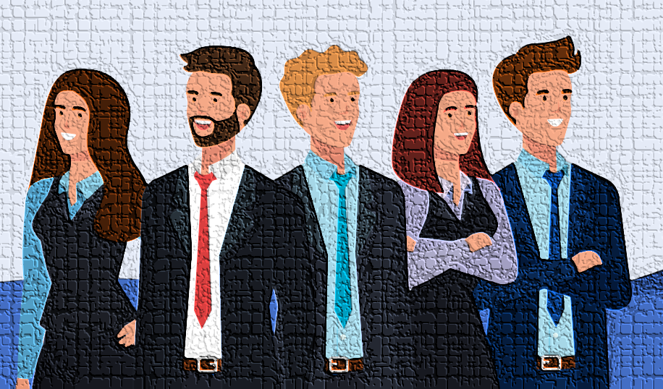
Unveiling HR Dynamics: A Journey through Data-Driven Employee Insights
By:- Anirudh Sahu (anirudh_sahu_12)

Slide 2
Introduction
About the Dataset:
54808 records and 9 columns, snapshotting our workforce's diverse aspects.
Relevance to HR Analytics:
It's not just data; it's the foundation for HR analytics – guiding strategic people management decisions.
Purpose of the Analysis:
Using Python and Jupyter, we'll clean, analyze, and visualize, seeking actionable insights.

Slide 3
Data Cleaning
Handle Missing Values:
'Education': Filled using the mode.
'Previous Year Rating': Utilized a combination of mode and median.
Drop Duplicates:
Detected and removed duplicate records.

Slide 4
Feature Engineering
Create New Features:
'score_service_ratio': Ratio of avg training score to length of service.
'awards_trainings_ratio': Ratio of awards won to (no of trainings + 1).
'training_interaction': Interaction term between no of trainings and avg training score.
Age Binning:
Implemented bins for age groups to facilitate analysis.

Slide 5
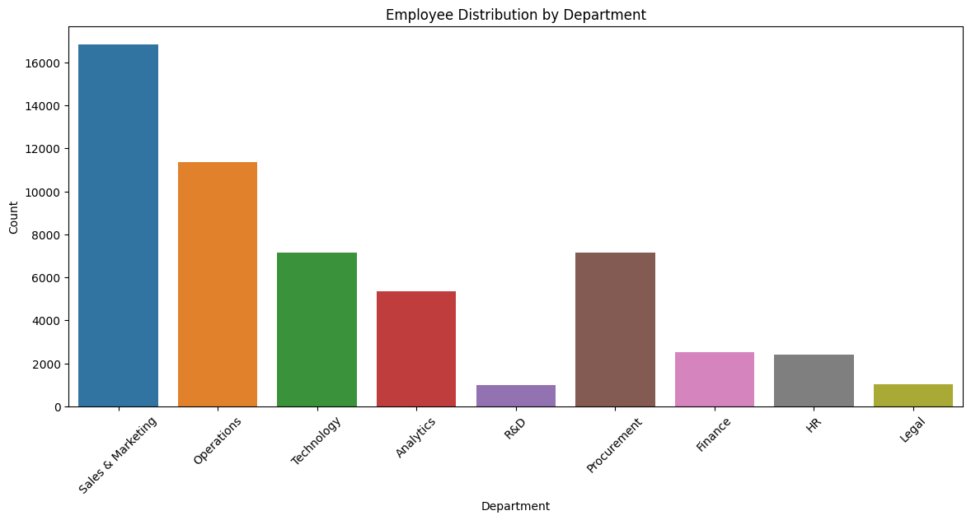
Distribution of Departments

Slide 6
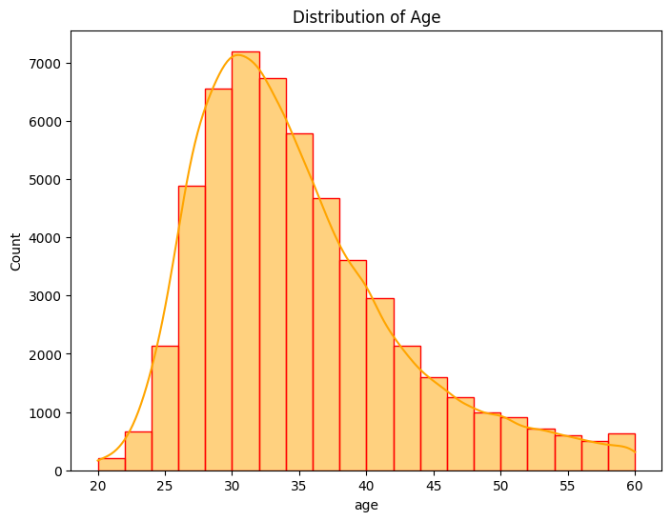
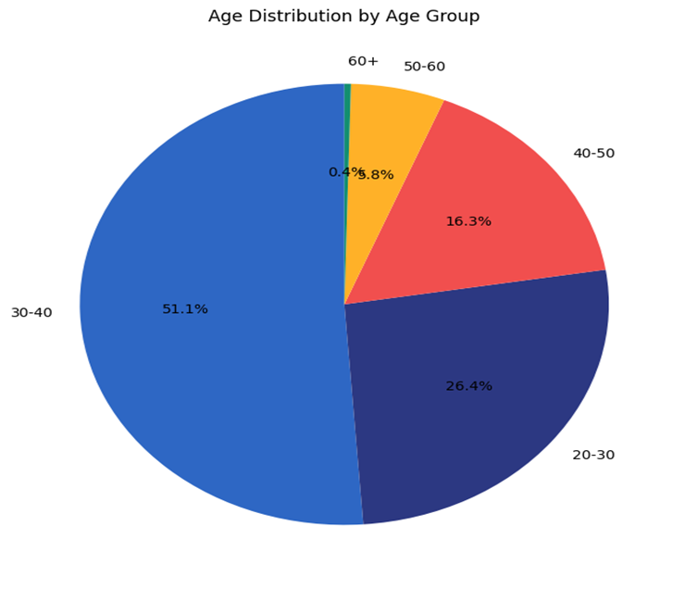
Distribution of age

Slide 7
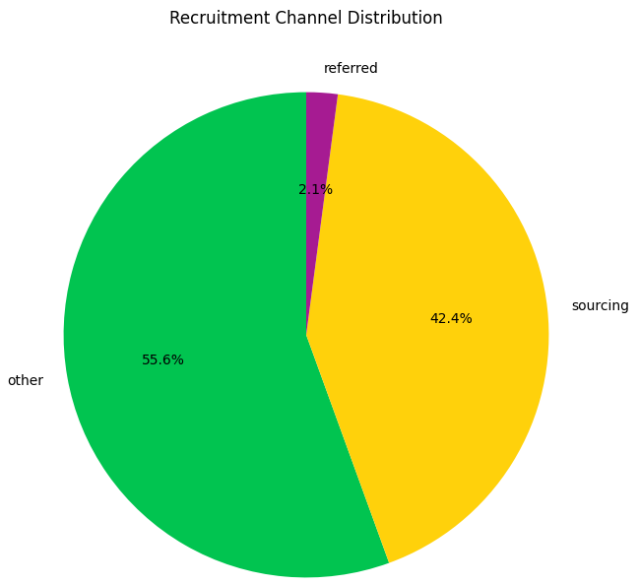
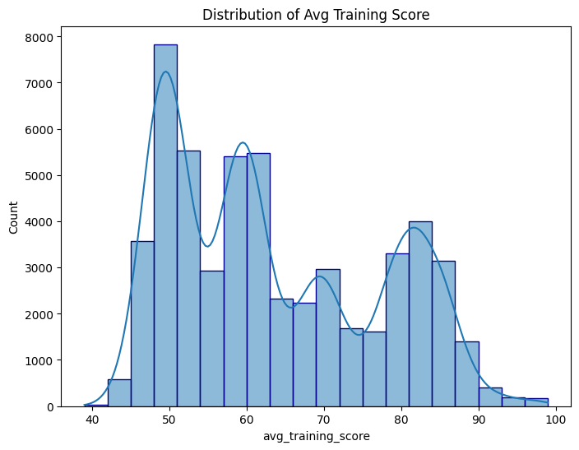
Distribution of RCD and training score

Slide 8
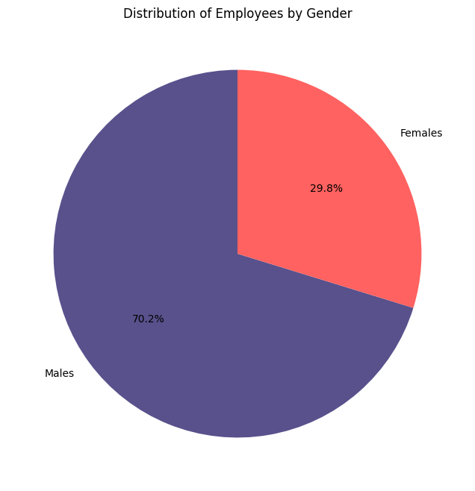
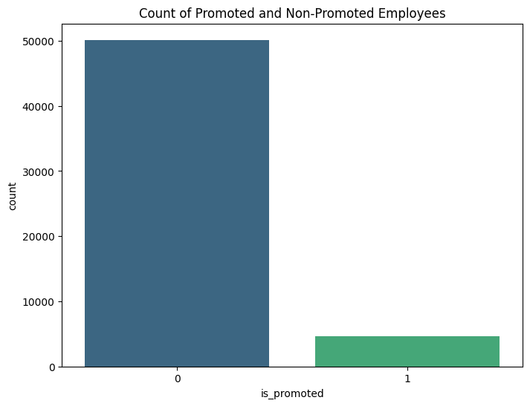
Distribution of Gender and promotion

Slide 9
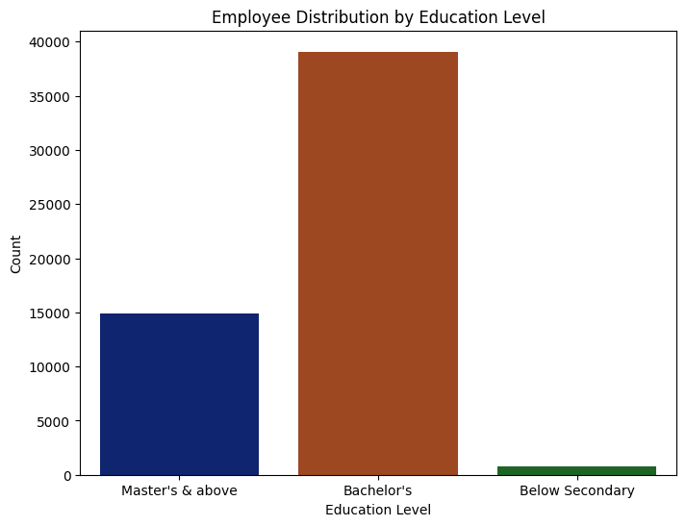
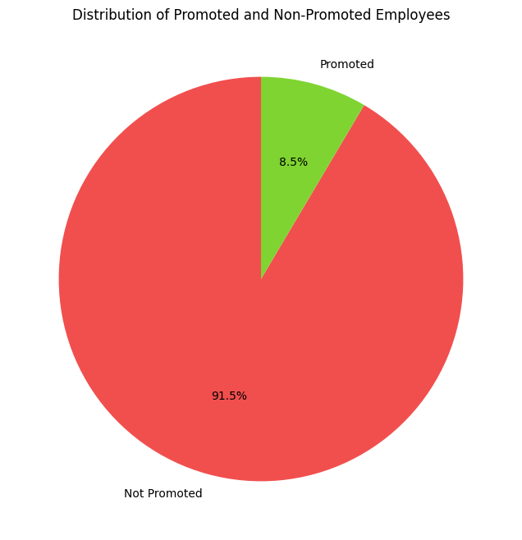
Distribution by education and promotion

Slide 10
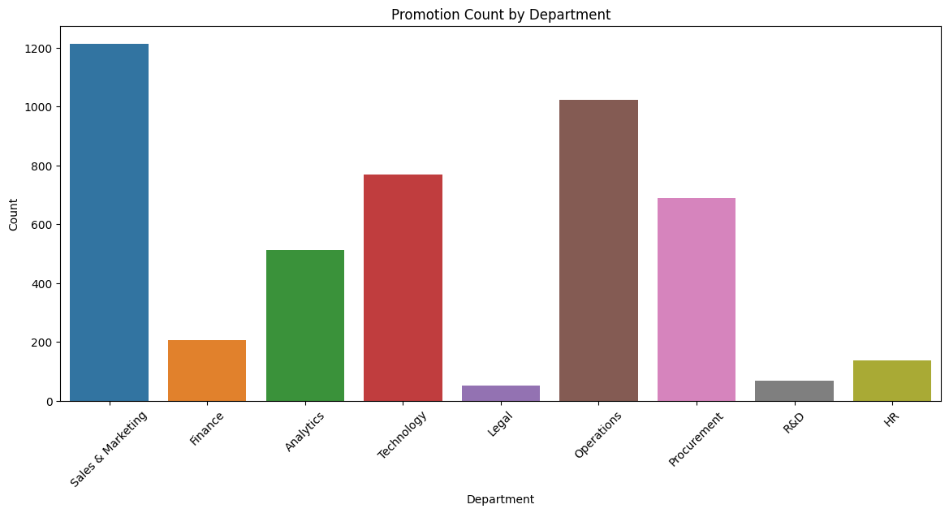
promotion count by departments

Slide 11
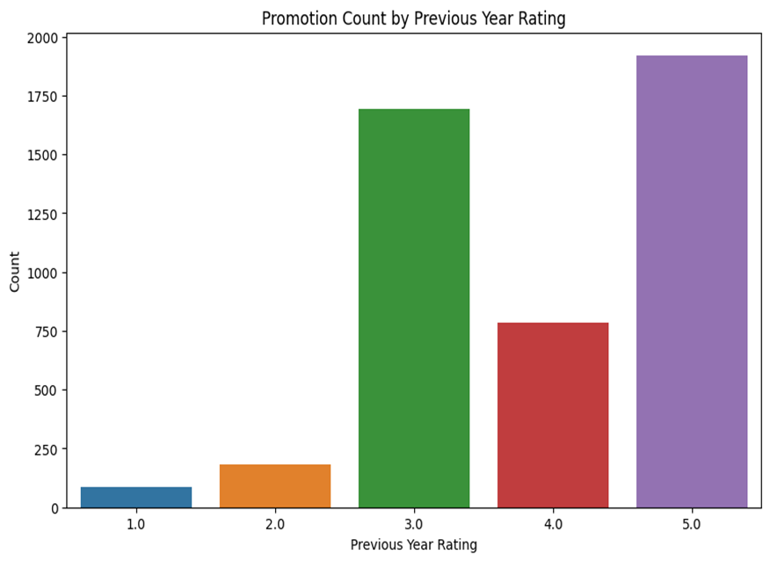
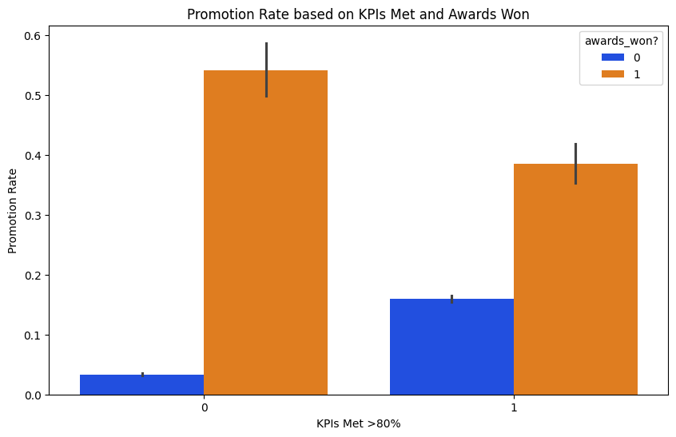
Promotion count by kpi ,pyr and awards

Slide 12
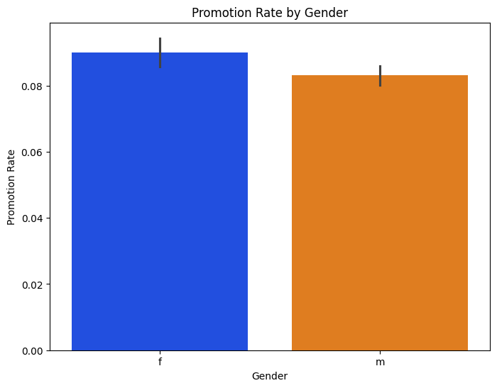
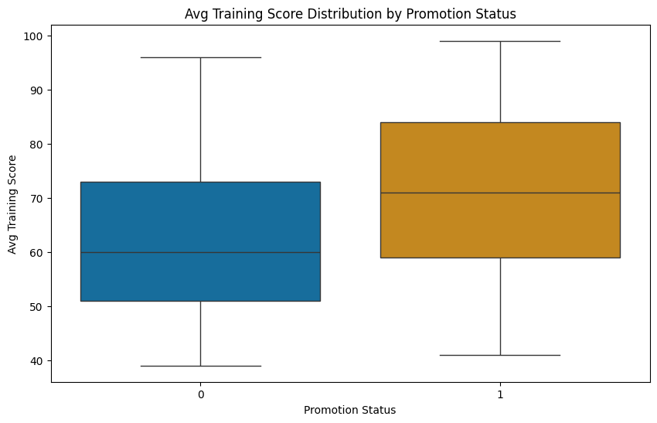
Promotion rate by gender and avg ts by promotion

Slide 13
Key Findings
Age Distribution:
Predominantly falls within the '20-30' age group.
Education and Gender:
Imbalanced distribution across education levels.
Gender distribution reveals a notable dominance of males
Promotion Patterns:
Positive correlation with high KPIs and awards.
Promotion rates exhibit equality between genders

Slide 14
Recommendations
Targeted Recruitment Strategies
Talent Development
Tailored Training Programs
Recruitment Optimization
Employee Engagement

Slide 15

Question and Answers

Slide 16


